Slide 1
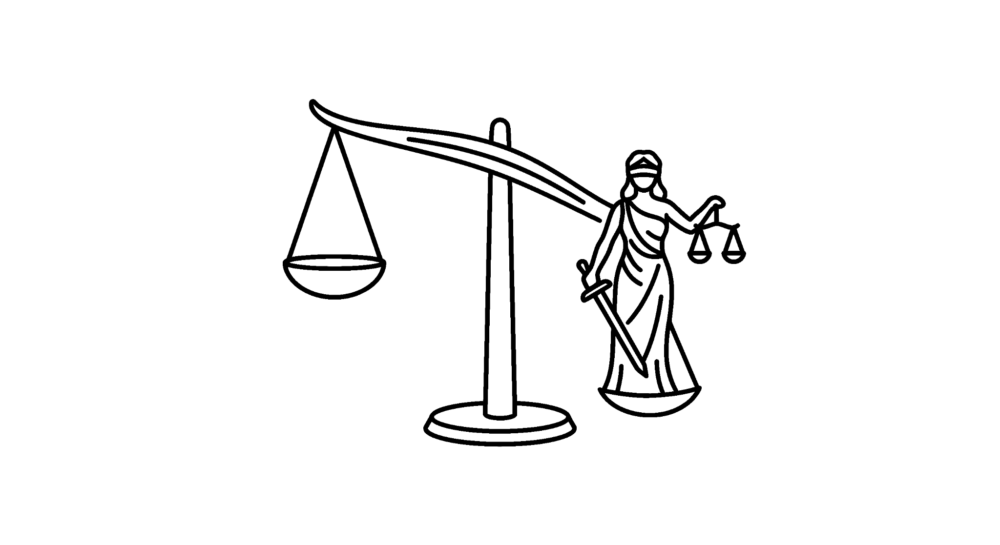
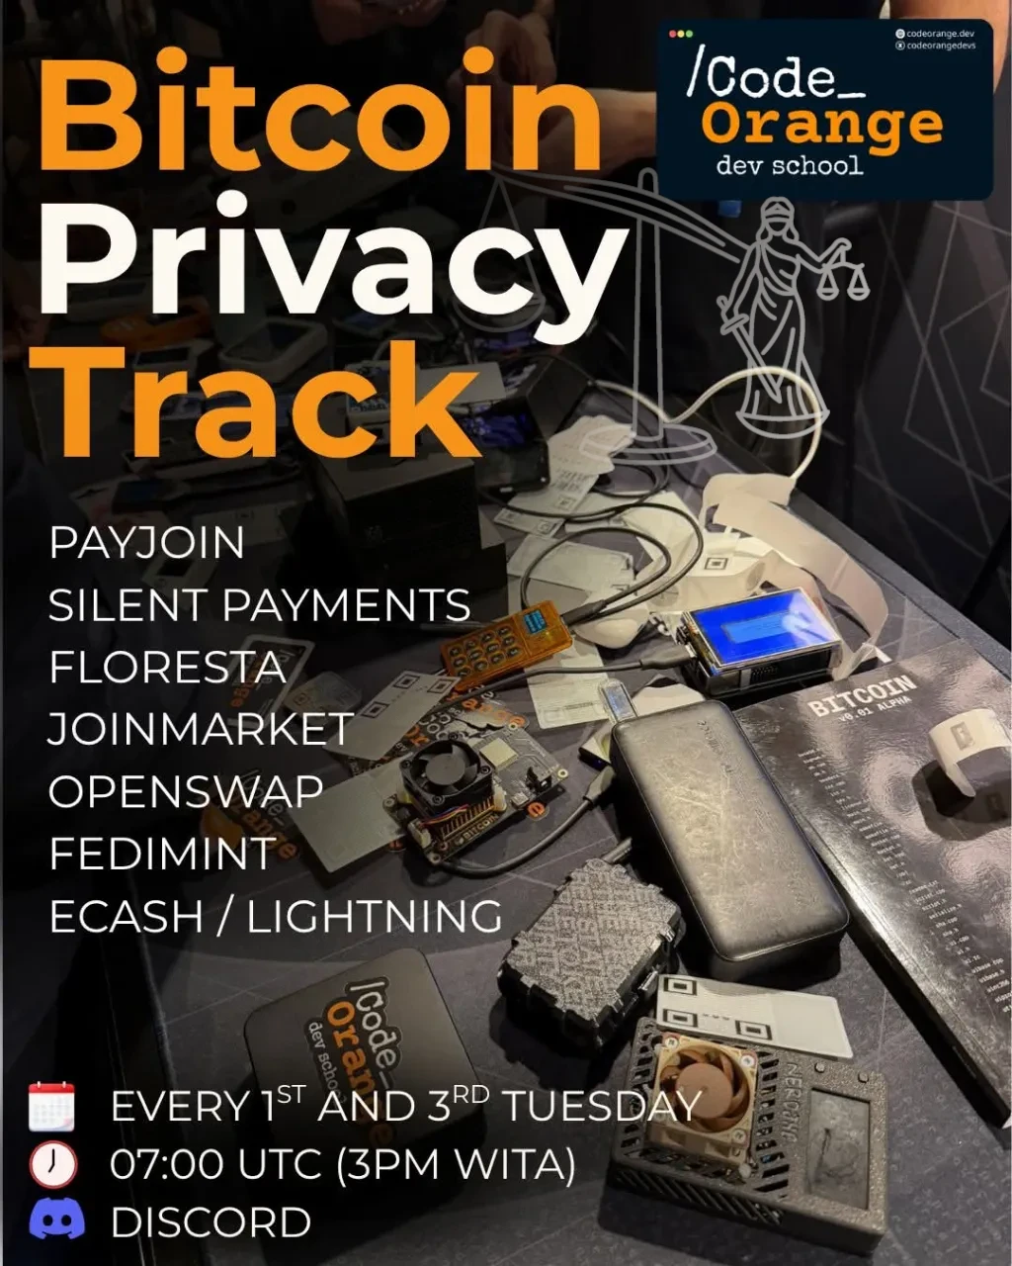
Payjoin
Breaking the common input ownership heuristic
6 Oct 2026
PRIVACY TRACK 2026

Slide 2
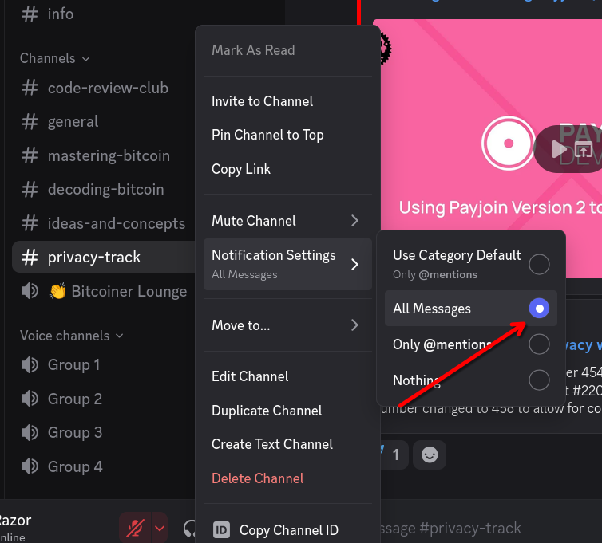
Get notified of all discord messages
PRIVACY TRACK 2026

Slide 3
Expectations
Present privacy issues in bitcoin
The present and future of solutions
Quizzes
Coding labs
Guidance for becoming a contributor
CTFs

Slide 4
Bitcoin Fog case
Bitcoin mixer between 2011-2021
Sterlingov was found guilty of: conspiracy, sting money laundering, operating an unlicensed money transmitting business
Moved more than 1.2 milllion btc ($400 million)
Chainalysis and IRS CI tracing methods used by investigators
Was it really chain analysis? We don’t know.
https://x.com/tayvano_/status/1387396128325263363

Slide 5
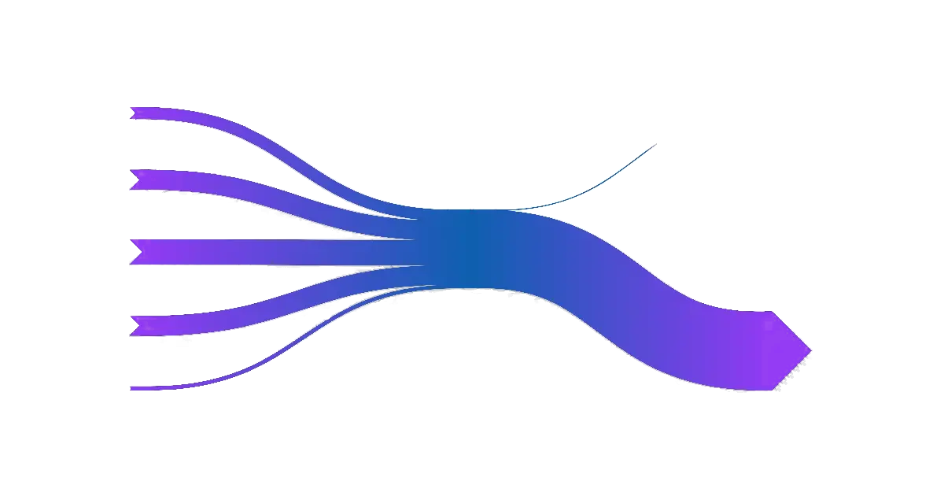
Common input heuristic

Slide 6
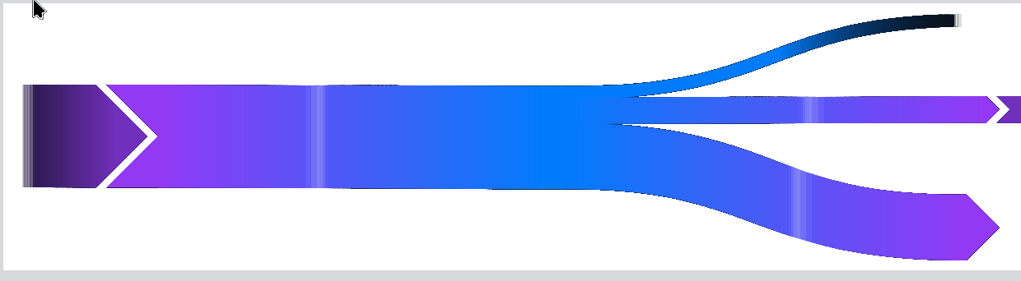
Change output detection

Slide 7
Payjoin (P2EP)
What if some of the inputs come from the receiver?
The sender asks the receiver for additional inputs
Two outputs: one for the sender, one for the receiver
In a way, both outputs are “change outputs”
Payjoin v2 (Async Payjoin)

Slide 8
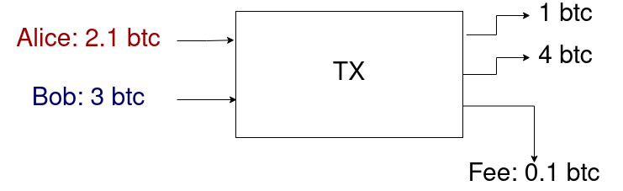
Example
Alice wants to send 1 btc to Bob and has a 2.01 btc UTXO
Bob has a 3 btc UTXO

Slide 9
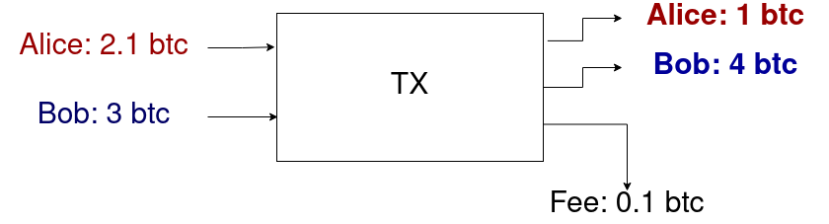
Analysis: Case I
Alice sends 1 btc to Bob

Slide 10
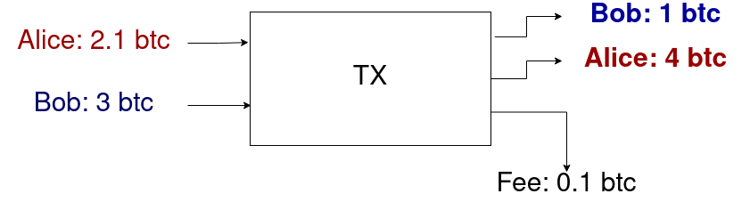
Analysis: Case II
Bob sends 2 btc to Alice

Slide 11
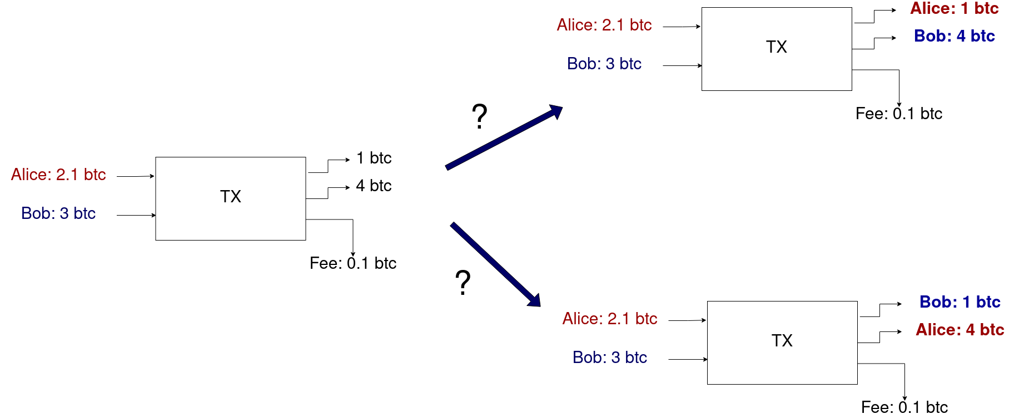

Slide 12
First challenge
Bustapay (BIP 79) was proposed in 2018
Why did it take so long?
Extra communication is needed

Slide 13
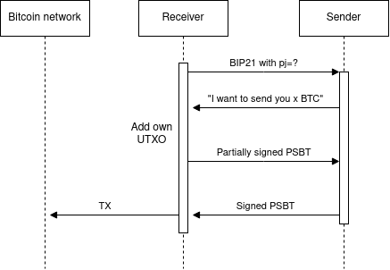
First try

Slide 14
First try
Issue: utxo snooping
The sender can spam the receiver with “I want to send you x BTC” requests and possibly learn all the UTXOs of the receiver

Slide 15
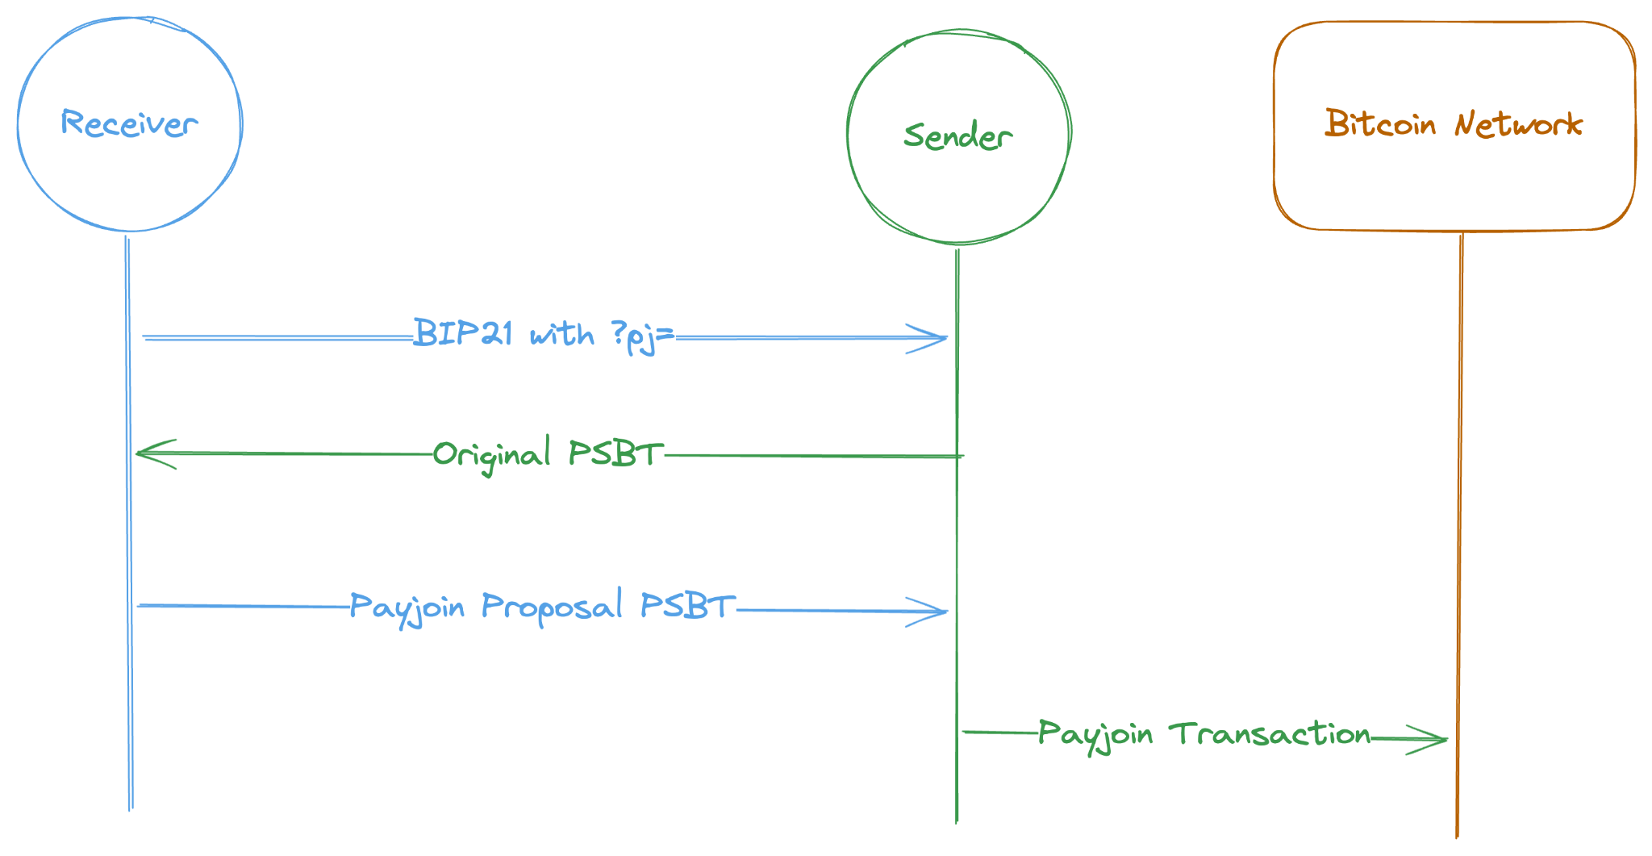
Payjoin v1

Slide 16
PSBT
Partially signed bitcoin transaction
Need: transactions need to be built in multiple steps
Version 0: BIP174
Version 2: BIP370
It’s a data format, not a signature strategy
Despite the name, they can be unsigned or fully signed (ready for chain)

Slide 17
Payjoin v2
In v1, the receiver needed to provide a trusted HTTP server
Therefore, someone else couldn’t host the server
In v2: Payjoin Directory (mailbox) was added
Payjoin Directory can be an untrusted third party
Oblivious HTTP (OHTTP) relay (also a third party)
As long as the OHTTP relay and the Payjoin Directory don’t collude, the exchange is secure

Slide 18
The future
Multiparty exchange

Slide 19
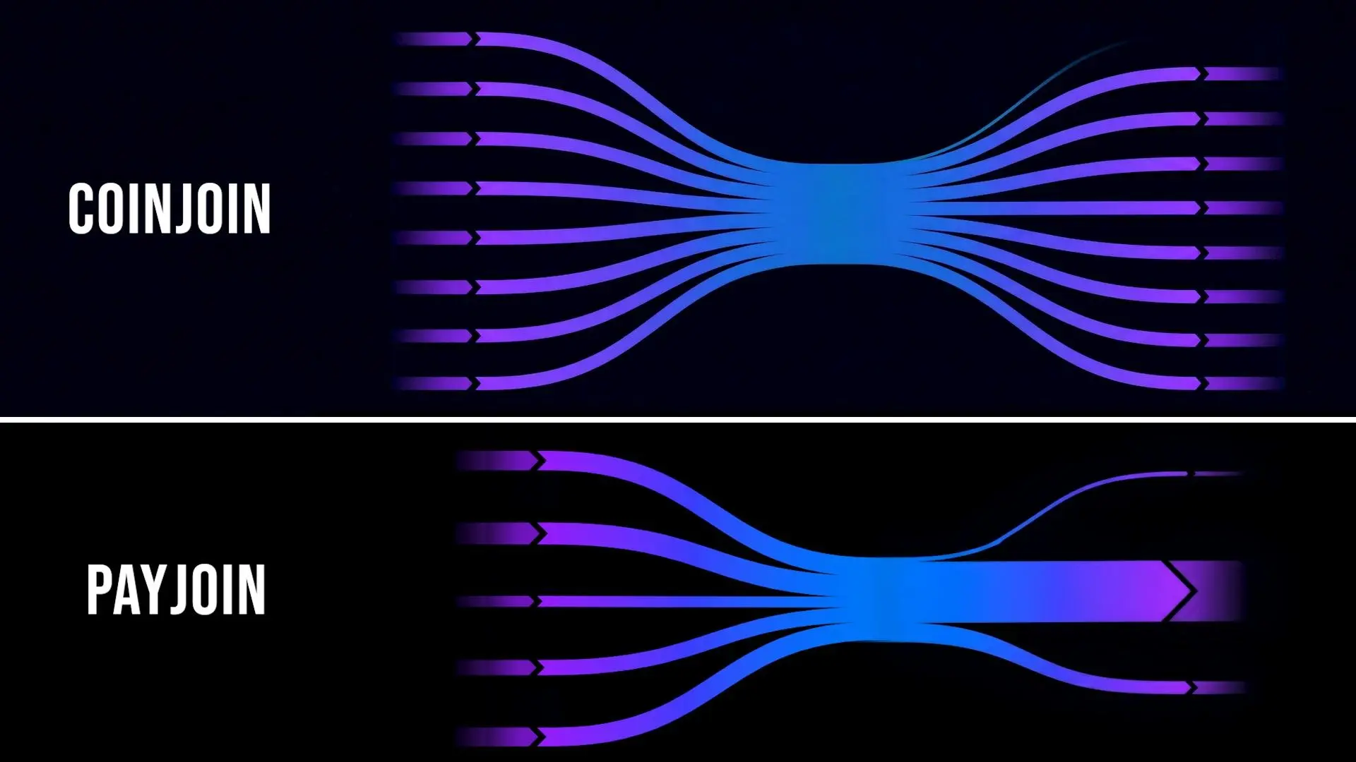
Payjoin vs Coinjoin

Slide 20
Quiz time

Slide 21
I want to learn
https://payjoin.org
https://coldcard.com/learn/bitcoin-privacy/what-is-payjoin
https://www.bullbitcoin.com/blog/what-is-payjoin-bitcoin-privacy-explained
In-depth discussion: https://www.youtube.com/watch?v=hX86rKyNB8I
https://www.youtube.com/watch?v=pybCDYbrgeQ

Slide 22
I want to contribute
Start by building and running the project
Break tests
Do reviews (it’s not that scary)
https://github.com/payjoin
https://github.com/ValeraFinebits/btcpayserver-payjoin-plugin
Not sure how? Reach out

Slide 23
References:
Bitcoin Fog reference 1: https://www.justice.gov/usao-dc/pr/operator-bitcoin-fog-sentenced-more-12-years-prison-running-notorious-darknet
Bitcoin Fog reference 2: https://amlnetwork.org/watchdog-database/cryptocurrency-laundering/bitcoin-fog-cryptocurrency-mixer/
Taylor Monahan on the Bitcoin Fog case: https://x.com/tayvano_/status/1387396128325263363

